Slide 1
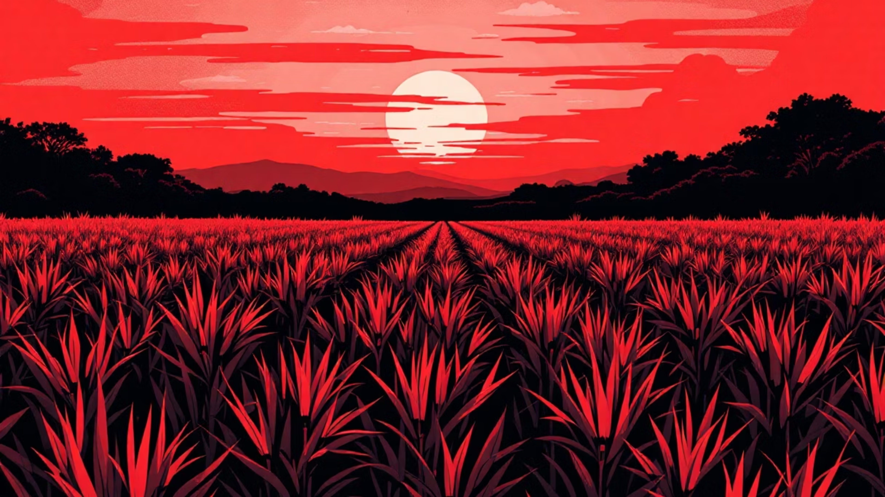
AI / ML in Sustainable Agriculture: Crop Disease Detection
This document outlines the foundational work for our project on applying AI/ML techniques to detect crop diseases, a critical step towards fostering sustainable agricultural practices. We delve into the problem's significance, explore existing research, characterize the chosen dataset, and present our detailed 4-week project roadmap.

Slide 2

The Imperative of Early Crop Disease Detection
Crop diseases pose a significant and escalating threat to global food security, leading to substantial yield losses and economic hardship for farmers. Annually, these diseases are responsible for diminishing agricultural productivity by an estimated 10-40% worldwide, translating into billions of dollars in lost revenue and increased food prices for consumers. Beyond economic implications, this directly exacerbates food insecurity, particularly in regions heavily reliant on agriculture for sustenance and livelihood.
"Timely intervention is the cornerstone of effective disease management in agriculture. Without it, the ripple effects can devastate livelihoods and food supplies."
Traditionally, disease detection relies on manual inspection by agricultural experts. This process is inherently slow, labor-intensive, and often requires specialized knowledge that isn't readily available to all farmers, especially those in remote or underserved areas. By the time visual symptoms become pronounced enough for manual identification, the disease may have already spread significantly, making treatment less effective or impossible.
How AI/ML Revolutionizes Detection
Artificial Intelligence and Machine Learning, particularly through advanced image analysis, offer a transformative solution. By leveraging AI/ML, we can achieve automated, rapid, and highly accurate disease detection, bringing multiple benefits:
Prevents Crop Losses: Early and accurate detection enables farmers to implement targeted interventions before diseases spread widely, significantly reducing crop damage and maximizing yields. This proactive approach minimizes the need for drastic measures like widespread culling.
Reduces Pesticide Overuse: Manual or broad-spectrum pesticide application often leads to overuse, harming the environment, beneficial insects, and potentially human health. AI-driven detection allows for precise, localized treatment, minimizing chemical input and promoting ecological balance.
Empowers Smallholder Farmers: Developing affordable and accessible AI-powered tools can democratize advanced agricultural practices. These tools provide small and medium-sized farmers with expert-level diagnostic capabilities, enabling them to make informed decisions without extensive training or costly traditional services.
Our motivation is rooted in creating tangible, positive impacts on agricultural sustainability, farmer prosperity, and global food security through cutting-edge technological applications.

Slide 3






Foundational Research in AI-Powered Crop Diagnostics
The application of Artificial Intelligence, specifically deep learning, to plant disease detection has been a burgeoning field over the last decade. Several pioneering studies have laid the groundwork for robust, automated diagnostic systems, demonstrating the immense potential of this technology. These foundational works provide crucial insights and benchmarks for our current project.
Mohanty et al. (2016)
Ferentinos (2018)
Real-World Applications
One of the earliest and most influential studies, "Using Deep Convolutional Neural Networks for Identifying Plant Diseases," demonstrated the power of Convolutional Neural Networks (CNNs) for this task. Using the PlantVillage dataset (which we will also utilize), they achieved an impressive accuracy of over 99% in identifying 14 crop species and 26 diseases. Their work validated the feasibility of CNNs for complex visual pattern recognition in agriculture.
Building on previous successes, "Deep Learning Models for Plant Disease Detection and Diagnosis" explored various deep learning architectures on a much larger scale. By utilizing over 87,000 images of healthy and infected plant leaves, this study achieved an astounding 99.5% accuracy. This research highlighted the robustness of deep learning models even with diverse datasets and reinforced the potential for real-world application.
The theoretical advancements have rapidly transitioned into practical tools. Mobile applications like Plantix and Leaf Doctor leverage similar AI models to provide instant disease diagnoses to farmers by simply uploading a photo of a diseased plant. These apps demonstrate the direct impact of this research, empowering farmers globally with accessible and effective diagnostic capabilities directly from their smartphones.
These studies collectively affirm the efficacy of deep learning in crop disease detection and underscore the potential for developing highly accurate and accessible solutions. Our project aims to further refine and apply these techniques to create a robust detection system.

Slide 4



The PlantVillage Dataset: Our Core Data Source
For our crop disease detection project, we have selected the widely recognized and publicly available PlantVillage dataset as our primary source of image data. This dataset is a cornerstone for research in this field due to its comprehensive nature and structured organization, making it ideal for training and evaluating deep learning models.
Key characteristics of the PlantVillage dataset include:
Extensive Image Collection: It comprises over 54,000 labeled images of healthy and diseased plant leaves. This large volume of data is crucial for training complex neural networks effectively, allowing them to learn subtle visual features associated with various diseases.
Diverse Crop Representation: The dataset covers 14 different crop species, providing a broad scope for generalizable disease detection. Examples of crops included are:
Apple
Tomato
Grape
Potato
Corn
And many others, including Peach, Pepper, Strawberry, etc.
Comprehensive Disease Coverage: Across these crops, the dataset identifies 38 distinct disease classes, in addition to healthy plant samples. This granularity allows for the development of models capable of differentiating between various diseases that might exhibit similar visual symptoms.
Standardized Image Format: All images within the dataset are standardized to a resolution of 256x256 pixels. This uniformity simplifies the preprocessing stage, ensuring consistency when feeding data into our convolutional neural networks and reducing computational overhead during model training.
The PlantVillage dataset's structure, variety, and quality make it an excellent choice for developing and validating our AI/ML models for crop disease detection. Its widespread use in previous successful research also provides a valuable benchmark for comparing our model's performance.

Slide 5
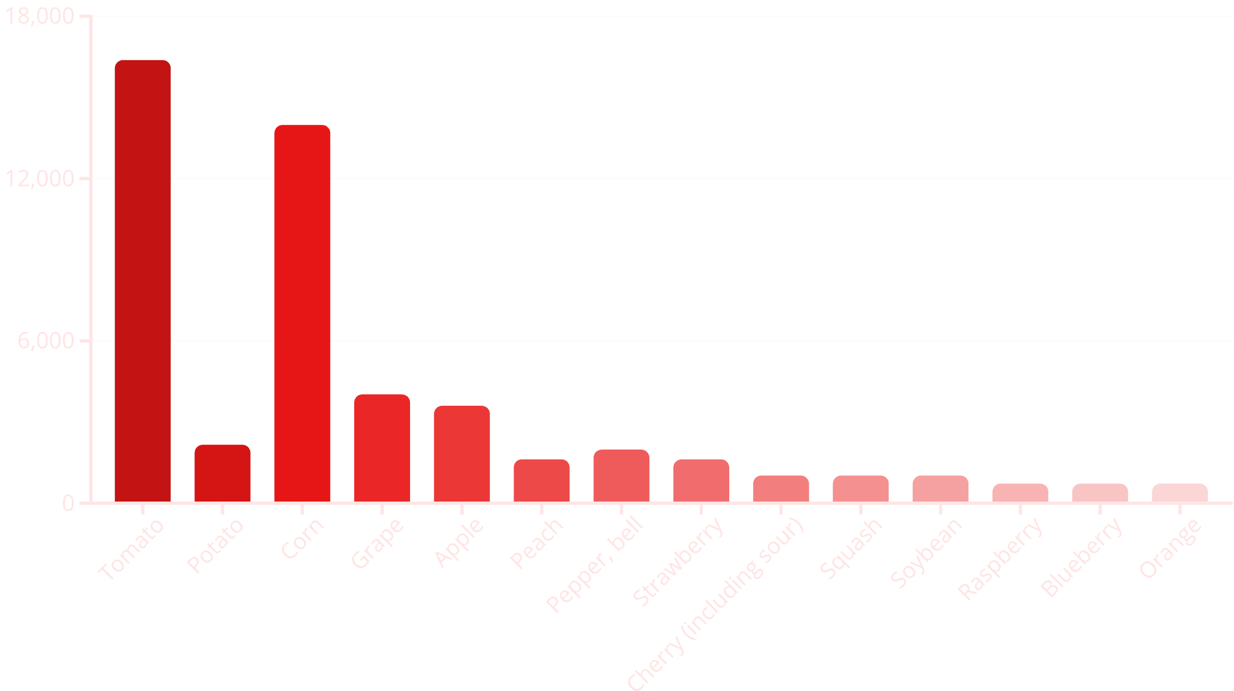

Exploratory Data Analysis: Image Distribution per Crop
Understanding the distribution of images across different crop types within the PlantVillage dataset is crucial for effective model training. An imbalanced dataset, where some crop classes have significantly more images than others, can lead to biased models that perform exceptionally well on over-represented classes but poorly on under-represented ones.
The chart below provides a visual overview of the number of images available for each of the 14 crop species in the dataset. This initial analysis helps us identify potential data imbalances that may require specific handling during data preprocessing, such as data augmentation or weighted loss functions.
As observed, Tomato and Corn varieties possess a significantly higher number of images compared to others, while crops like Raspberry, Blueberry, and Orange have fewer samples. This imbalance highlights the need for strategies such as oversampling minority classes or employing data augmentation techniques to ensure our models learn robustly from all crop types and their associated diseases.

Slide 6
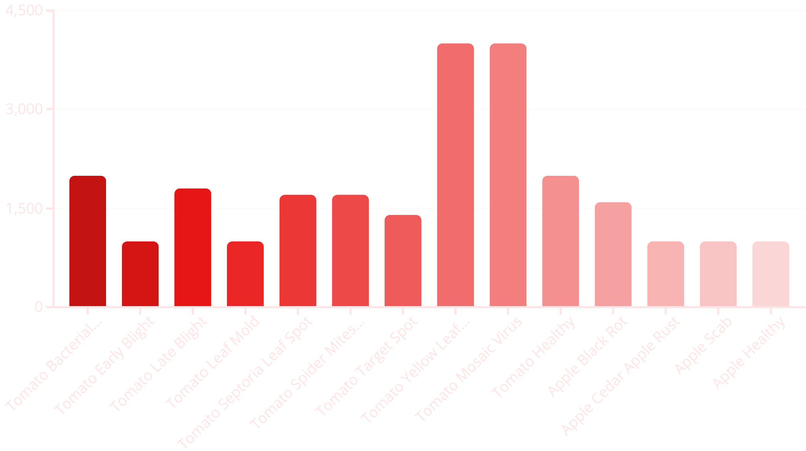

Exploratory Data Analysis: Disease Class Distribution per Crop
Beyond the overall image count per crop, it's equally vital to analyze the distribution of specific disease classes within each crop type. Some diseases might be over-represented, while others are scarce, posing a challenge for the model to learn and generalize effectively for all diagnostic categories. This granular understanding is critical for fine-tuning our training approach and ensuring comprehensive disease detection capabilities.
The chart below illustrates the number of images per disease class for a selection of key crops. This detailed view helps us identify specific disease imbalances and plan for appropriate data handling strategies, such as weighted sampling or synthetic data generation, for rare disease instances.
As illustrated, some disease classes like Tomato Yellow Leaf Curl Virus and Tomato Mosaic Virus are particularly well-represented. Conversely, certain diseases might have fewer samples, demanding careful consideration during model training to prevent overfitting on abundant classes and to ensure effective generalization across all 38 disease categories. This EDA will guide our data augmentation and sampling strategies in the upcoming preprocessing phase.

